Slide 1

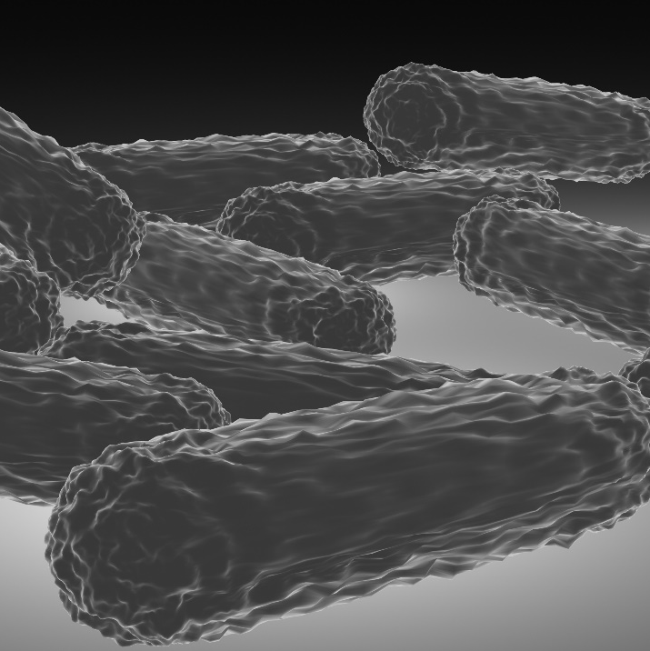
Detection of Genetic Polymorphism
Life Science
Chapter 3 - Document 4
Bacilli in 3D illustration (by M. Ouaidat)
Grade : Secondary Education – Third year
Section : Life Sciences - English
Part : I

Slide 2

1
Isolation of DNA
2
Restriction Enzymes
3
Gene Cloning
4
Gel Electrophoresis
4
5
Restriction Fragment Length Polymorphism
5
Third Secondary Year/Part I/ Life Sciences - English

Slide 3
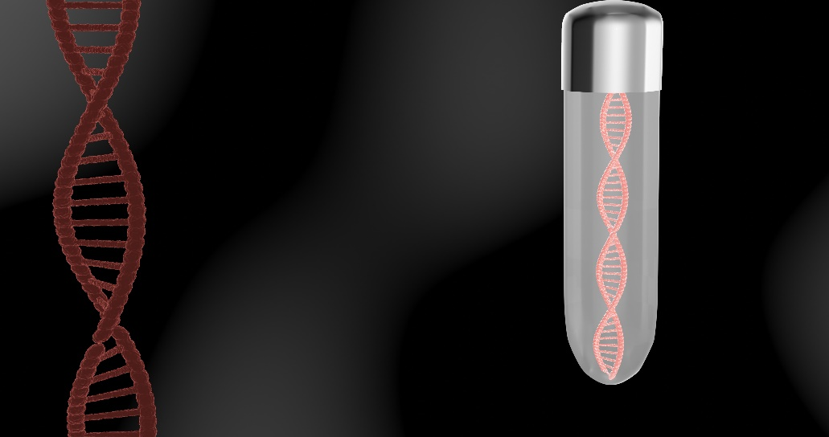
Genetic variation and polymorphism are greatly responsible for the diversity of the individuals within a population.
How is this variation detected?
Doc1: DNA molecule in 3D illustration (by M. Ouaidat)
Third Secondary Year/Part I/ Life Sciences - English

Slide 4
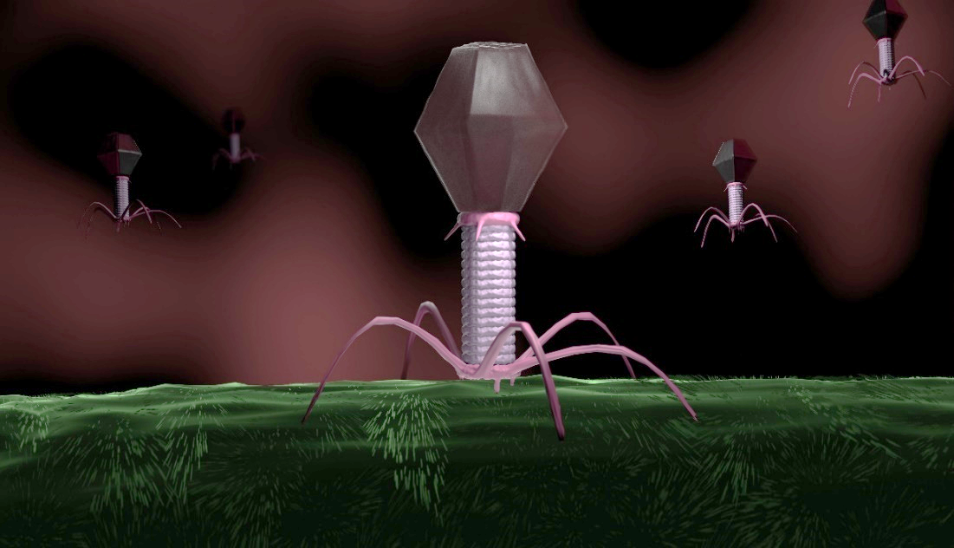
What is a restriction enzyme?
A restriction enzyme, also called restriction endonuclease, is a protein produced by bacteria that cleaves DNA at specific sites along the molecule.
A bacterium uses a restriction enzyme to defend against bacterial viruses called bacteriophages.
Restriction enzymes can be isolated from bacterial cells and used in the laboratory to cut DNA into smaller fragments in order to study differences and similarities in fragment length among individuals.
Doc2: Bacteriophage infecting a bacterium (by M. Ouaidat)
1- Pick out, from the text, the origin of the restriction enzymes.
Bacteria
2- What is the importance of these enzymes:
2-1. in bacteria?
A bacterium uses a restriction enzyme to defend against bacterial viruses called bacteriophages.
Third Secondary Year/Part I/ Life Sciences - English

Slide 5
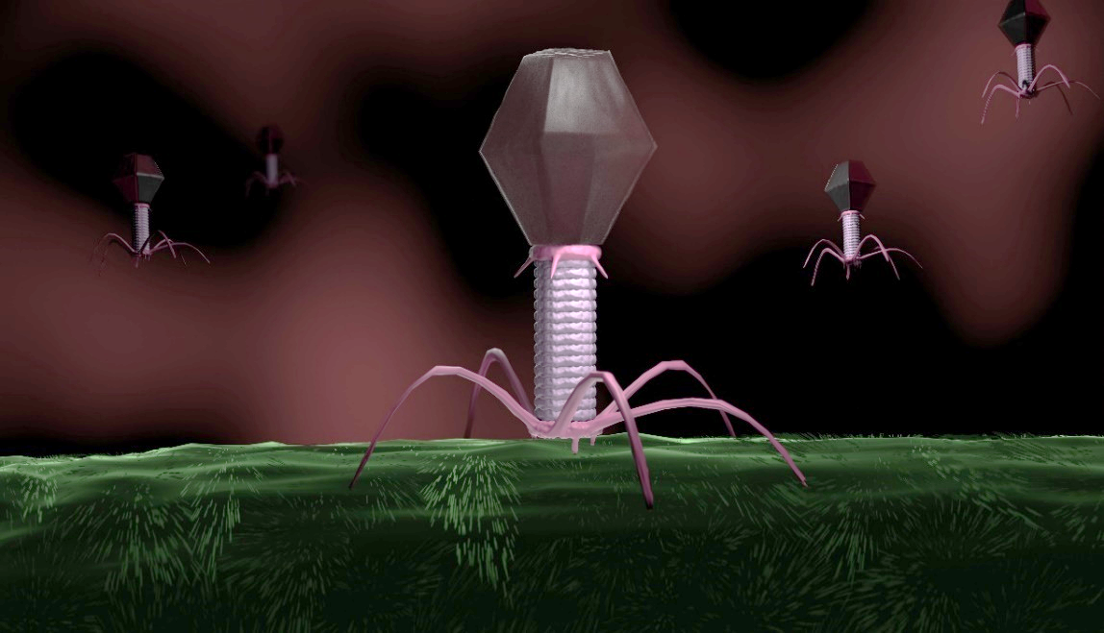
What is a restriction enzyme?
A restriction enzyme, also called restriction endonuclease, is a protein produced by bacteria and it cleaves DNA at specific sites along the molecule.
A bacterium uses a restriction enzyme to defend itself against bacterial viruses called bacteriophages.
Restriction enzymes can be isolated from bacterial cells and used in the laboratory to cut DNA into smaller fragments in order to study differences and similarities in fragment length among individuals.
Doc2: Bacteriophages infecting a bacterium (by M. Ouaidat)
2- What is the importance of these enzymes:
2-2. for human?
To cut DNA into smaller fragments in order to study differences and similarities in fragment length among individuals.
Third Secondary Year/Part I/ Life Sciences - English

Slide 6
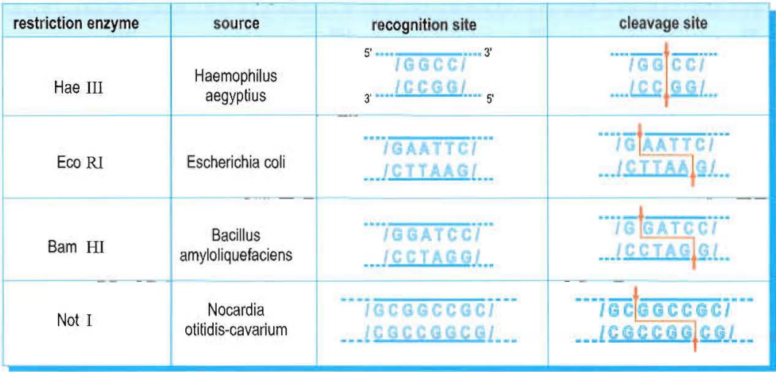
What is a restriction enzyme?
Each restriction enzyme recognizes a short and specific sequence of nucleotide bases. These regions are called recognition sequences, or recognition sites, and are randomly distributed throughout the DNA, usually 4 to 8 base pair long.
Document 3 shows some examples of restriction enzymes and their restriction sites while document 4 shows the cleavage of a bacterial DNA molecule by two different restriction enzymes, Not I and Eco RI.
Doc3: Restriction enzymes and their restriction sites ( CRDP)
3- Specify, referring to document 4, the number of the restriction sites for each enzyme (Not I and Eco RI) found in the bacterial DNA molecule.
The number of restriction sites for Not I is three since this enzyme cuts the DNA molecule into 4 fragments.
The number of restriction sites for Eco RI is six since this enzyme cuts the DNA molecule into 7 fragments.
Doc4: DNA molecule cut with different restriction enzymes –( CRDP)
Third secondary year/part I/ Life Sciences - English

Slide 7
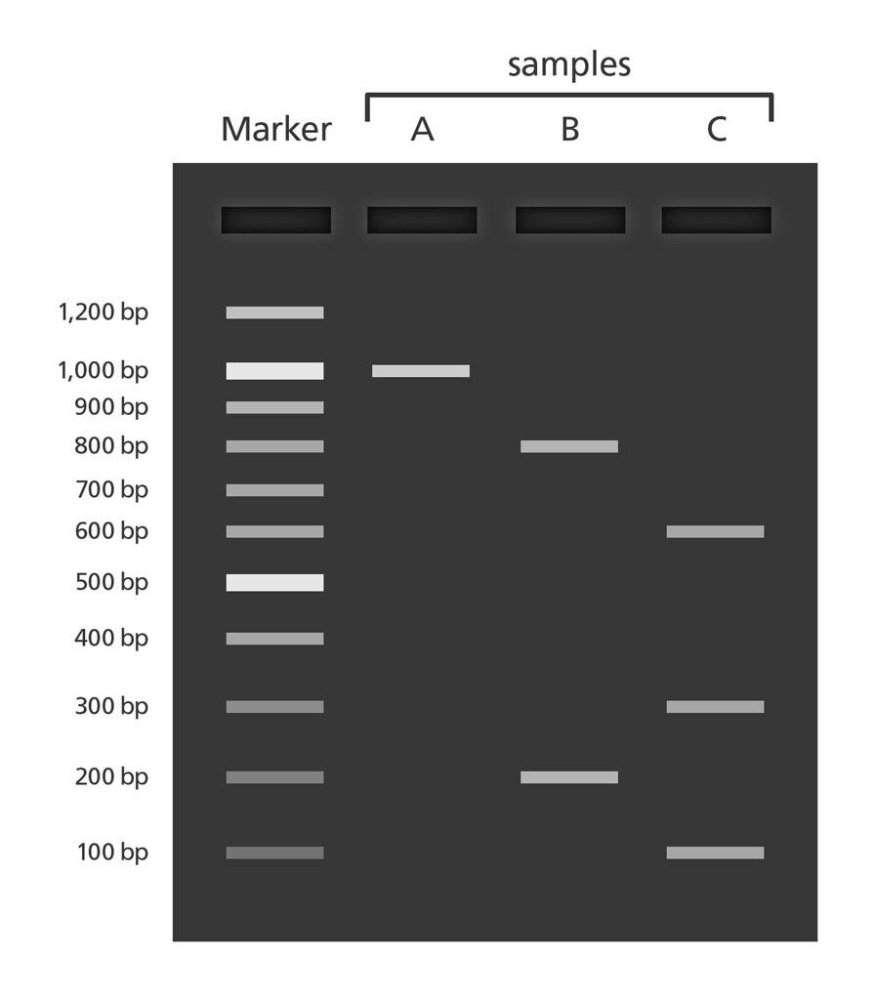
Gel electrophoresis
Click the link below to observe a video about gel electrophoresis; then answer the questions which follow.
https://www.youtube.com/watch?v=KsMd3LZ0Rvo&list=UU70I-YRzPRWO-E315lHXIMA&index=29
4- What is the aim of the DNA gel electrophoresis?
It is a technique used to separate the DNA fragments on a semi-solid gel.
5- Indicate the direction of migration of the DNA fragments on the gel. Justify your answer.
DNA fragments in the semi-solid gel migrate from the negative electrode to the positive one due to the presence of phosphate groups that charge the DNA negatively.
6- What does the distance of migration of each DNA fragment depend on?
It depends on the size of DNA fragments: the longest DNA fragments are the nearest to the well while the shorter ones travel farther distance on the gel.
Doc5: DNA gel electrophoresis bands
https://www.flickr.com/photos/yourgenome/26344046544
Third Secondary Year/Yart I/ Life Sciences - English

Slide 8
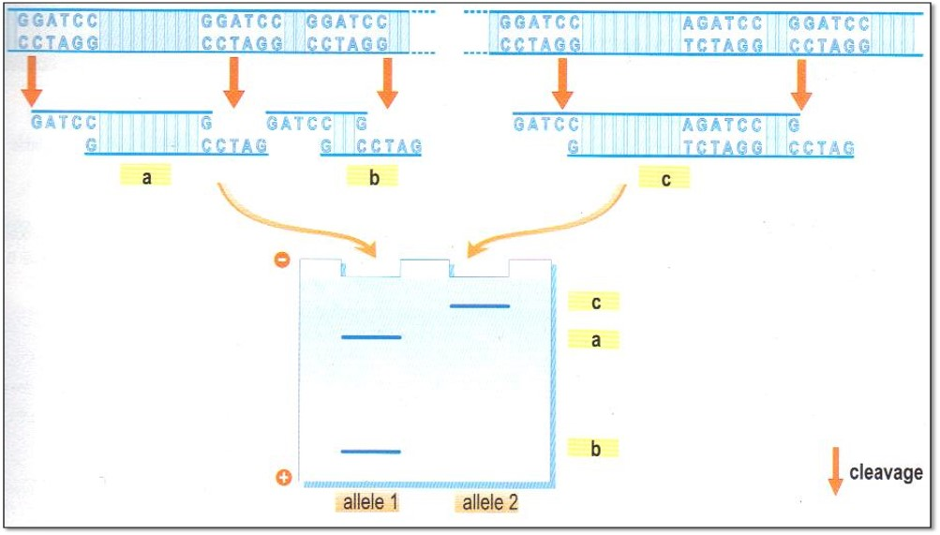
Gel Electrophoresis
Document 6a shows the electrophoresis of a fragment of each of two different alleles, allele 1 and allele 2, treated by the same restriction enzyme, Bam HI.
7- Explain the obtained results.
As shown in document 6a, two bands “a” and “b” appear after electrophoresis of allele 1 while one band “c” appears on the gel for allele 2 after treating both alleles with Bam HI . There exists an additional restriction site in allele 1 which is absent in allele 2 due to substitution of nucleotide G by A in allele 2 that leads to the modification of the restriction site that becomes unknown by Bam HI. Consequently, allele 1 shows two bands due to being cleaved at this site to two fragments while allele B will not be cleaved at this same site due to the absence of recognition sequence, and eventually will end up with one longer fragment.
Allele 1
Allele 2
Doc6a: Electrophoresis of two different alleles cleaved
by the same restriction enzyme (CRDP)
Third secondary year/part I/ Life Sciences - English

Slide 9
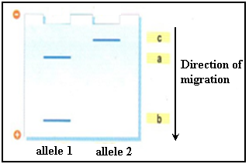
Gel Electrophoresis
Document 6b shows the electrophoresis of a fragment of each of two different alleles, allele 1 and allele 2, cleaved by the same restriction enzyme, Bam HI.
8- Classify the fragments a, b, and c according to their decreasing length. Justify the answer.
c-a-b since the distance traveled by each DNA fragment is inversely proportional to its size. Band “c” is the nearest band from the well, which means that it is the longest one and band “b” is the farthest one from it, which means that it is the smallest one.
Doc6b: Electrophoresis of two different alleles cleaved by the same restriction enzyme (CRDP)
Third Secondary Year/Part I/ Life Sciences - English

Slide 10
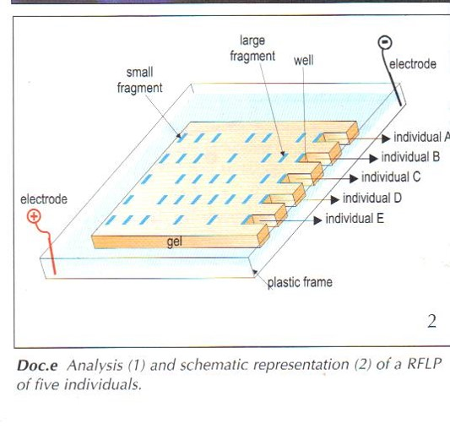
Restriction fragment length polymorphism (RFLP)
Restriction fragment length polymorphism, or RFLP, is the difference among individuals in the lengths of DNA fragments cut by restriction enzymes. After a segment of DNA has been cut into pieces with restriction enzymes, researchers can examine the fragments using gel electrophoresis.
If two individuals have differences in their DNA sequences at particular restriction sites, then the restriction enzymes will cut their DNA into fragments of different lengths. There may also be differences in the number of DNA fragments observed among two or more individuals. RFLP analysis can be used as a form of genetic testing to detect whether an individual carries a mutant gene for a disease that runs in his or her family.
Doc7: Schematic representation of a RFLP of five individuals. (CRDP)
9-Define “RFLP”.
RFLP is the difference among individuals in the lengths of DNA fragments cut by restriction enzymes.
10- Pick out the importance of RFLP analysis.
It can be used as a form of genetic testing to detect whether an individual carries a mutant gene for a disease that runs in his or her family.
Third Secondary Year/Part I/ Life Sciences - English

Slide 11
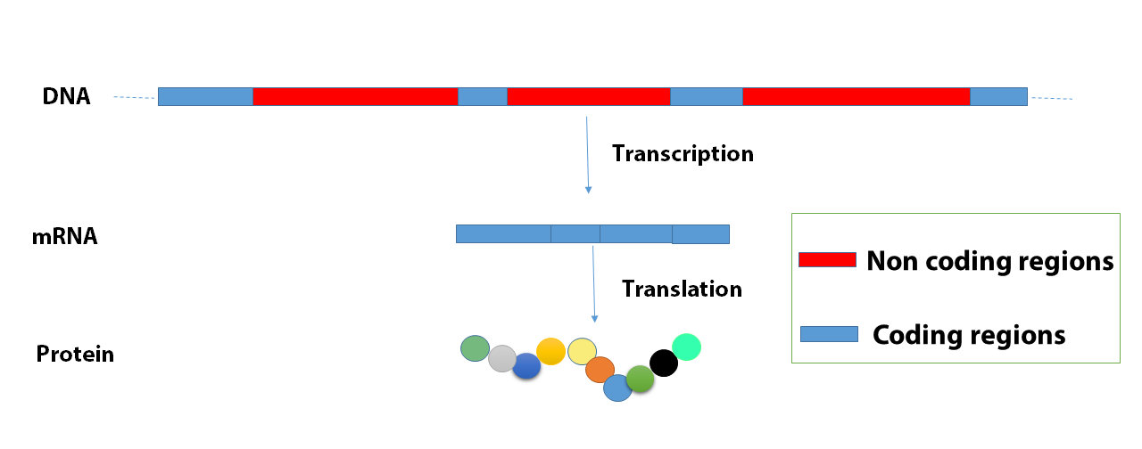
Restriction fragment length polymorphism (RFLP)
A DNA molecule is composed of coding sequences and non coding sequences. Only the coding sequences code for proteins. Over 98% of the human genome are non coding regions.
11- In which region does mutation affect the phenotype? Justify your answer.
In coding regions since these are the only regions that code for proteins, gene expression, which determine the phenotype.
Doc8: Protein synthesis and gene splicing (by M. Ouaidat)
Third Secondary Year/Part I/ Life Sciences - English

Slide 12
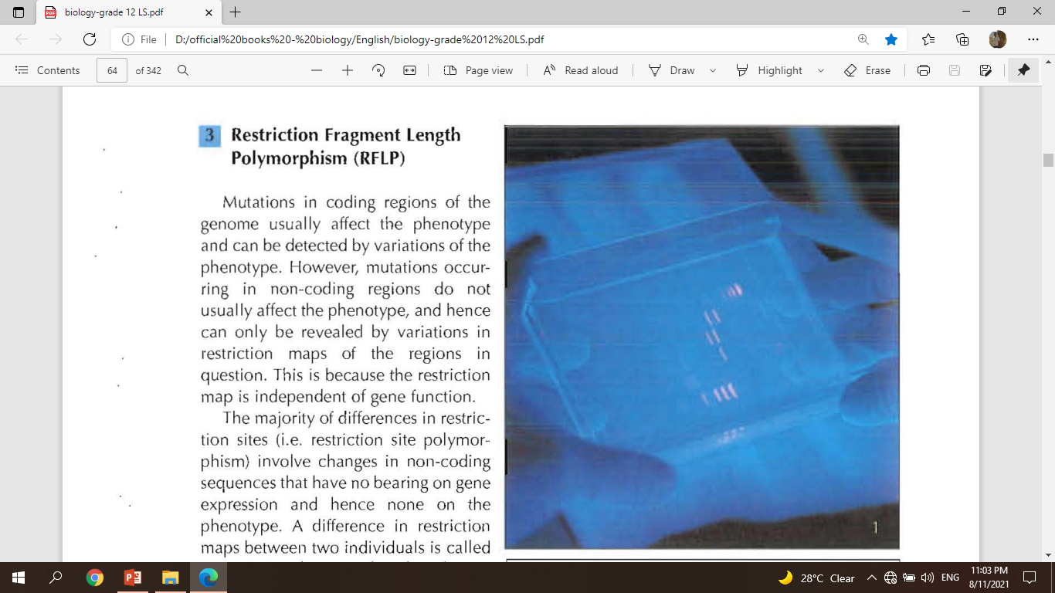
Restriction fragment length polymorphism (RFLP)
12- Explain the following statement: “The restriction map is independent of gene function”.
A restriction map depends on differences in restriction sites of the DNA, and these are distributed throughout the genome, in both coding and non-coding regions. Thus, when comparing RFLP’s of two organisms, the difference in sequence of nucleotides in all regions is assessed regardless if it’s a part of a coding region of a gene which is expressed or a part of non coding region which is not expressed.
Doc9: RFLP analysis (CRDP)
A restriction map is the generated pattern of bands shown on the gel of electrophoresis.
Third Secondary Year/Part I/ Life Sciences - English

Slide 13
1
Choose the correct answer(s).
1- A linear DNA segment is cut by a restriction enzyme into 5 fragments if it possesses the following number of restriction sites for the enzyme:
a. 4.
b. 5.
c. 6.
d. 7.
2- The mutations that do not affect the phenotype are:
a. Silent mutations.
b. Mutations of coding regions.
c. Mutations of non-coding regions.
d. Mutations by deletion.
Third Secondary Year/Part I/ Life Sciences - English

Slide 14
2
Three copies of a DNA molecule of size 1400 base pairs (bp) of
a mouse cell are treated and cut in three independent experiments by:
the restriction enzyme BAM HI only.
the restriction enzyme Eco RI only.
a mixture of Eco RI and Bam HI.
The DNA fragments produced by the three independent experiments were separated by electrophoresis on agarose gel then stained with ethidium bromide. The RFLPs obtained at the end of experiments are represented in document 2.
EcoRI
BamHI
EcoRI + BamHI
800bp
600bp
550bp
450bp
400bp
250bp
200bp
1. Specify the number of restriction sites in the DNA molecule for each of the enzymes EcoRI and Bam HI.
Doc2: Gel electrophoresis of the DNA molecule cut with EcoRI only, BamHI only, and both EcoRI and BamHI (by M. Ouaidat)
Third Secondary Year/Part I/ Life Sciences - English

Slide 15
1. Specify the number of restriction sites in the DNA molecule for each of the enzymes EcoRI and Bam HI.
EcoRI has one restriction site since the restriction map of the DNA shows two bands corresponding to two fragments, one of size 800bp and the other of size 600bp.
EcoRI
BamHI
EcoRI + BamHI
800bp
600bp
550bp
450bp
BamHI has two restriction sites since the
restriction map of the DNA shows three bands
corresponding to three fragments, of size:
550bp, 450bp, and 400bp.
400bp
250bp
200bp
Doc2: Gel electrophoresis of the DNA molecule cut with EcoRI only, BamHI only, and both EcoRI and BamHI (by M. Ouaidat)
Third Secondary Year/Part I/ Life Sciences - English

Slide 16
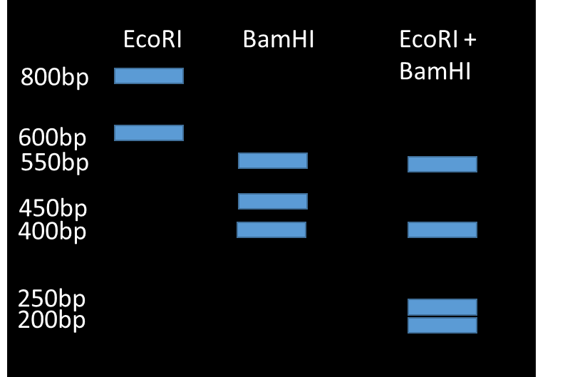
2. Draw, based on document 2, one possible restriction map of the restriction enzymes acting on the DNA molecule.
EcoRI
600bp
800bp
BamHI
400bp
450bp
550bp
EcoRI
+
Doc2: Gel electrophoresis of the DNA molecule cut with EcoRI only, BamHI only, and both EcoRI and BamHI (by M. Ouaidat)
BamHI
400bp
200bp
250bp
550bp
Restriction map of the DNA molecule (by M. Ouaidat)

Slide 17
National Textbook- Third Secondary Year-Life Sciences- CRDP.
https://www.youtube.com/watch?v=KsMd3LZ0Rvo&list=UU70I-YRzPRWO-E315lHXIMA&index=29
https://www.flickr.com/photos/yourgenome/26344046544
Third Secondary Year/Part I/ Life Sciences - English

Slide 18
Coordinator: Rana Abdallah
Author: Mohamad Ouaidat
Reviewer: Sahar Ibrahim
Language Editor: Mariam Antar
Translator: Leila Miski

